Slide 1

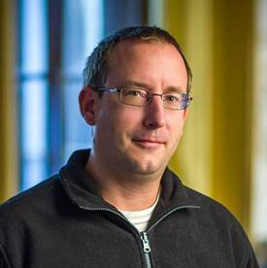
Péter JOLÁNKAI
7th Demo
1.12.2017.
Pallida Cohort - Static Class
Hardware programing

Slide 2

This week we met an old friend

Slide 3
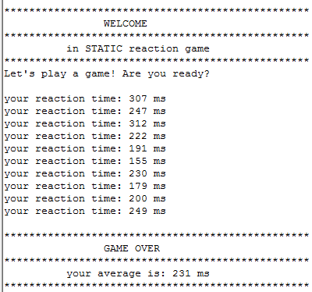
I got a 0.231 ms average in the STATIC reaction game (STM32 board based game)

Slide 4
After this I got a permission to finish my ARDUINO project
Project aim:
Measure air temperature and humidity,
and display in a 2row 16 character LCD
Panel with I2C

Slide 5
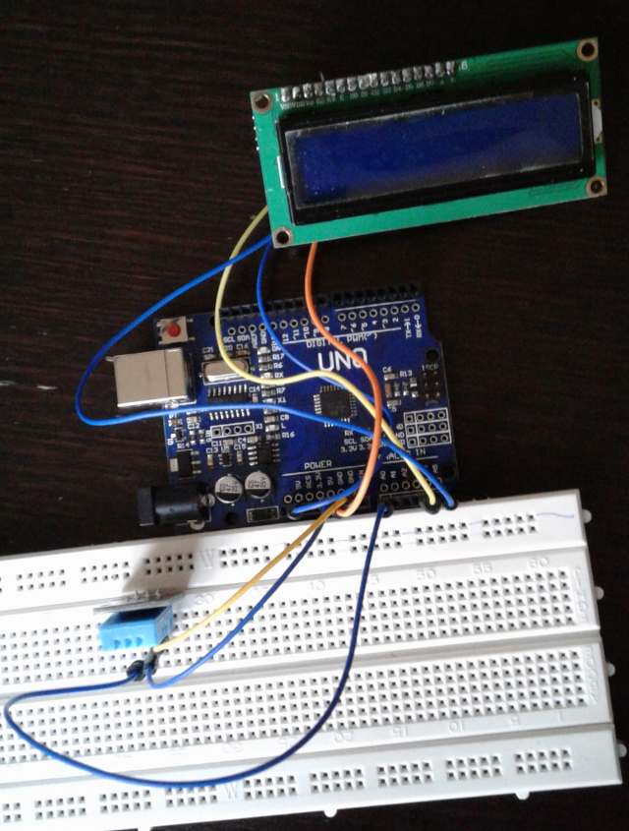
Components of a system:

Slide 6
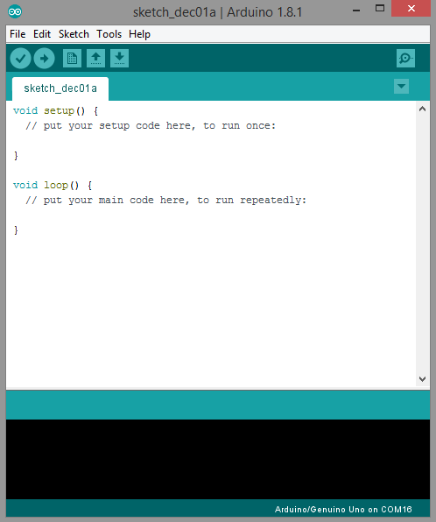

Slide 7
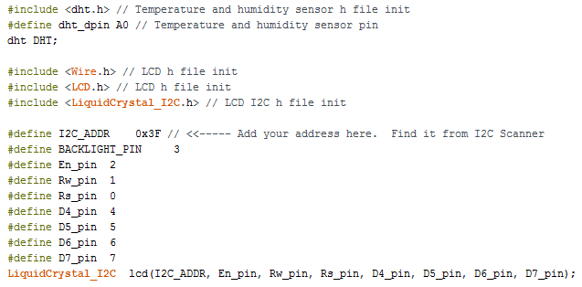

Slide 8
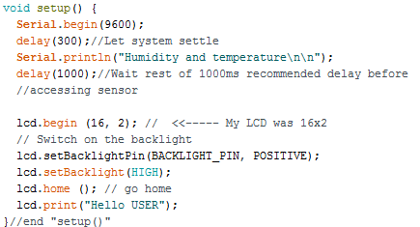

Slide 9
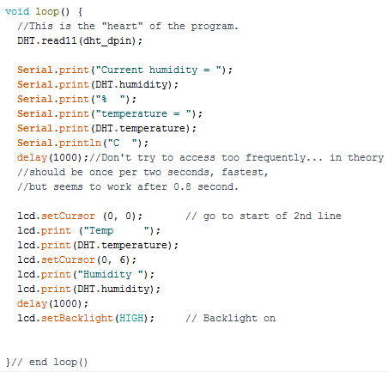

Slide 10

Thank you for your attention!

